Slide 1
Image Encryption with Sparse Autoencoder
Howard Yong and Shivansh Srivastava
Notes:
- Type up script
- Record presentation
- Finish report
- Submit
- 1 report, pdf with just text
- Code
- Clean up directory (document our
ipynb, include README with startup
instructions, )
- Github upload
-
- Video recording

Slide 2
Problem
Deep learning becoming rampantly more common, driving storage and consumption of data
Personally identifiable information may be contained in data (e.g., faces)
Often stored without consumer realization
Can pose a significant threat during data breaches or attacks
There is a demand for useful, secure representations of images that can be stored and utilized by trustworthy parties only
Adversarial attacks using ML can learn and reconstruct images despite blurring and shuffling pixels around
Ideal solution is develop compact codes and gives freedom over the amount of info that can eventually be decrypted
Notes:
Howard

Slide 3
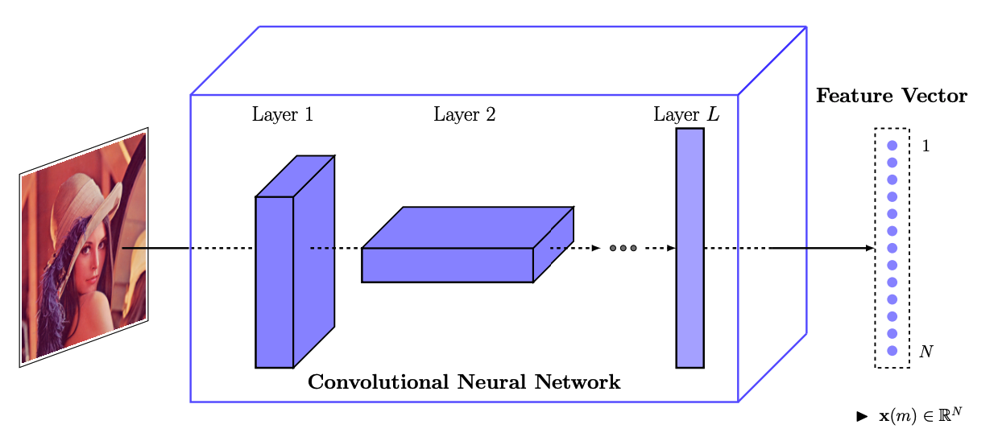
Solution
Utilize autoencoders to learn latent representations of images that can be shared securely
Lower dimension versions of images can be shared as “code” and encrypted with noise when sharing publicly
Using stacked linear layers to output multiple codes in the latent space
Key for decryption is index of correct code
Figure by https://tinyurl.com/697whjyd
Notes:
Howard

Slide 4
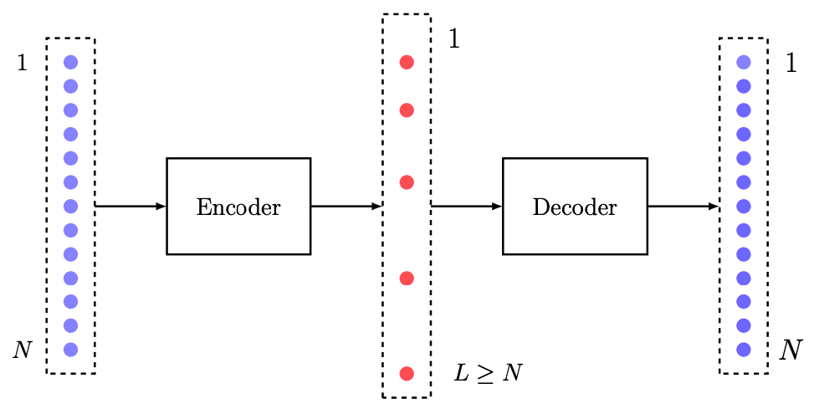
Solution
Latent representations (or “code”) need to allow control of image resolution during reconstruction
Training with sparsity allows control of image resolution during reconstruction
Inject sparsity into latent space by collecting only top k-non zero values during training
Figure by https://tinyurl.com/697whjyd
Notes:
Howard

Slide 5
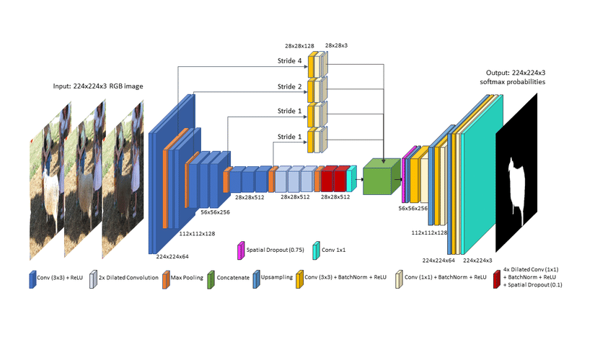
Architecture - Iteration 1
Figures by https://tinyurl.com/2n3em9sj
Notes:
Shivansh

Slide 6
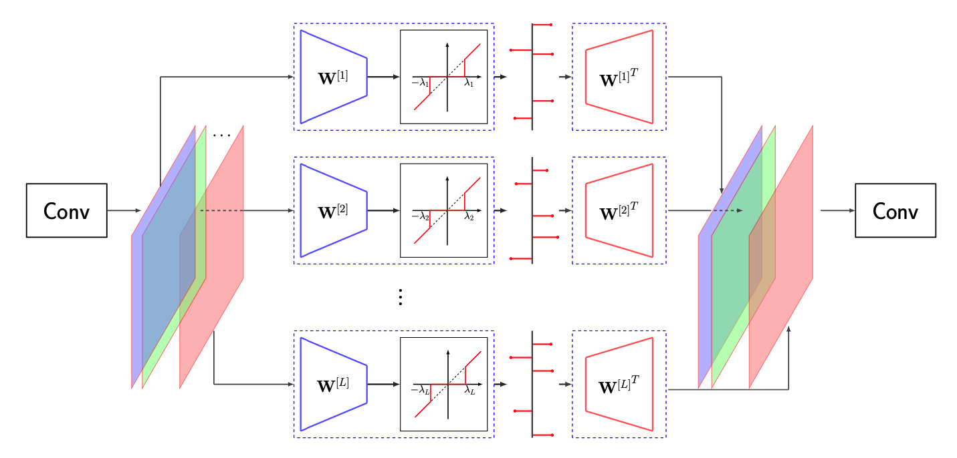
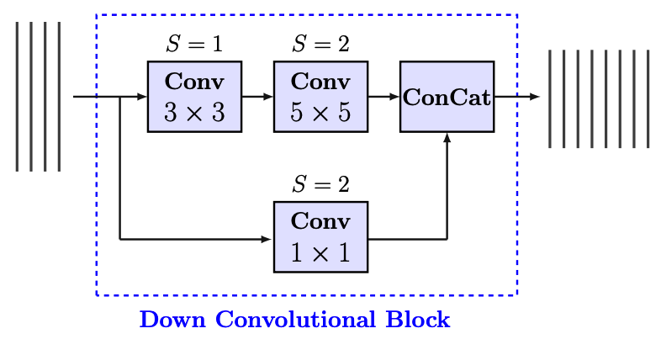
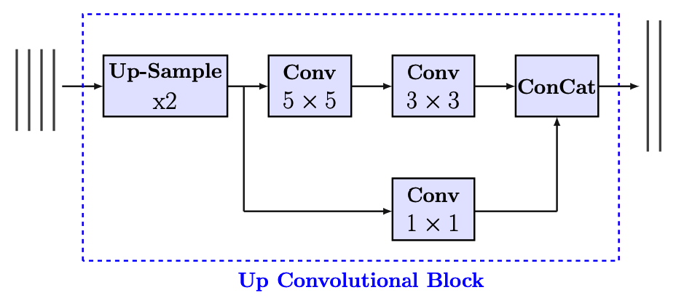
Architecture - Iteration 2
Figures by https://tinyurl.com/697whjyd
Notes:
Shivansh

Slide 7
Training Info
3 Training Iterations
VGG-16 Autoencoder
Architecture from Ferdowsi et. al (2020) with VGG-16 filter sizes and layers
Modified model architecture from Ferdowsi et. al (2020):
Injected additional convolutional layers in upsampling blocks, decreased number of blocks in encoder and decoders, changed filter sizes, changed scaling factor ratios
Dataset: Large-scale CelebFaces Attributes (CelebA) Dataset
Used 20,000 out of ~200,000 images
Training/Validation/Testing = 80-10-10 split
Trained for 10 epochs
Notes:
Shivansh

Slide 8
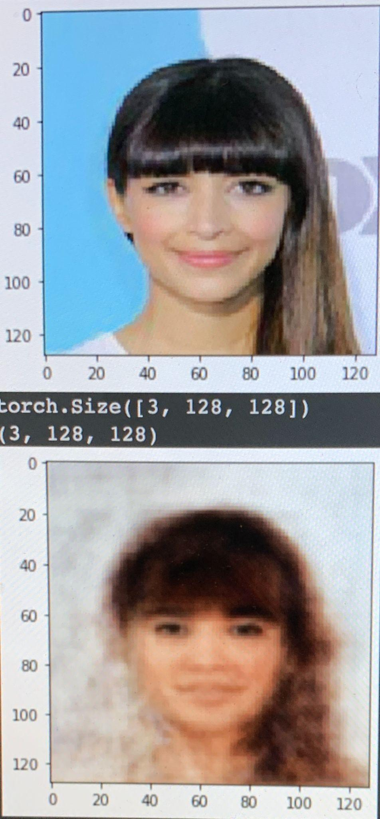
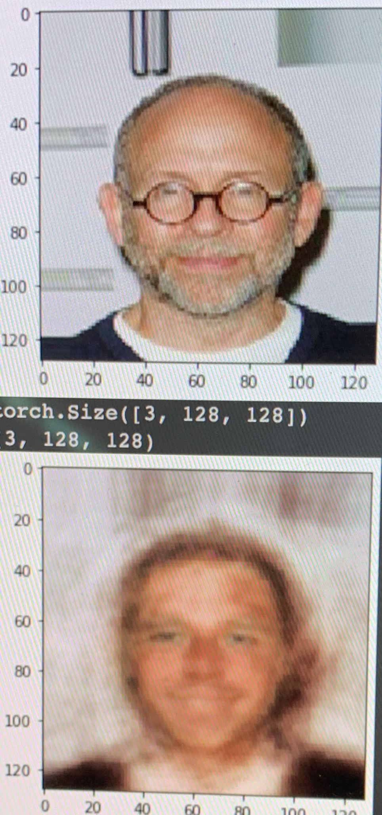
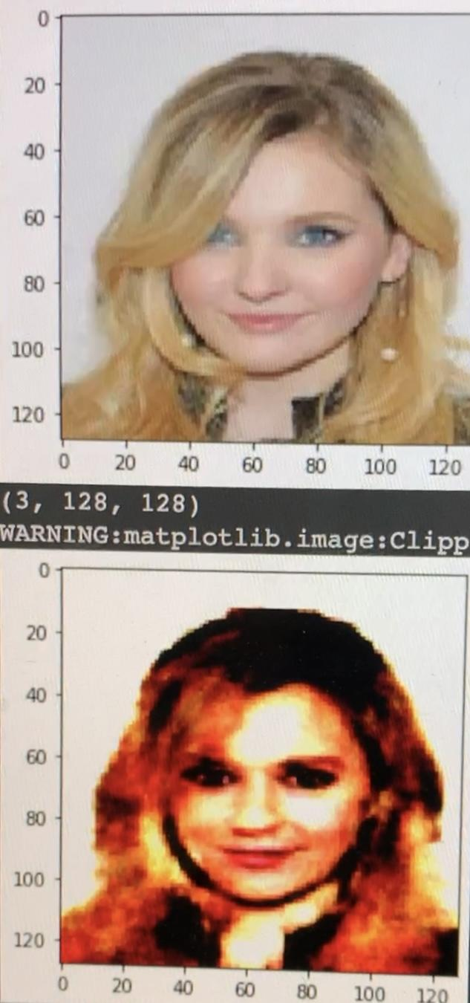
Preliminary Results
Training 1, Columns 1-2
Results from VGG-16 based autoencoder
Training 2, Column 3
Result from motivated architecture but with identical kernel sizes
Notes:
Howard

Slide 9
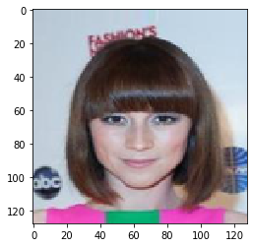
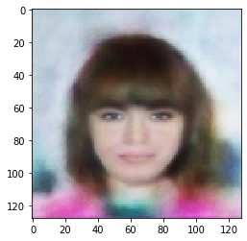
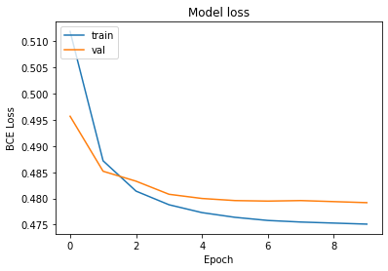
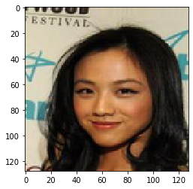
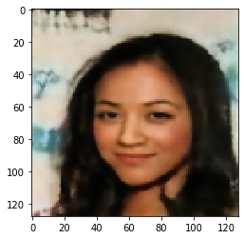
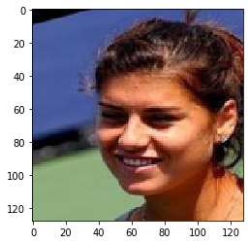
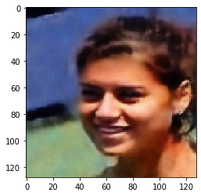
Results - Training/Validation
Epoch 1
Epoch 6
Epoch 10
Notes:
Howard

Slide 10
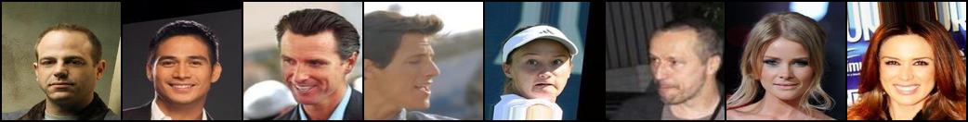
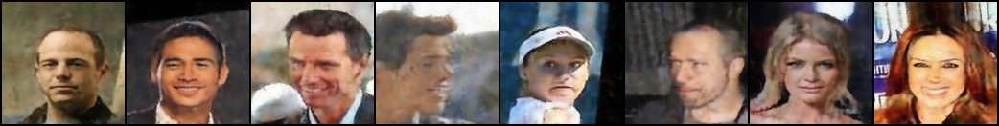
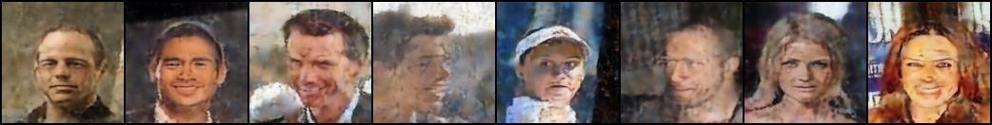
Results - Reconstruction
Input
k = 128
k = 64
Notes:
Shivansh

Slide 11
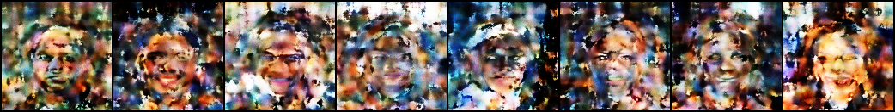
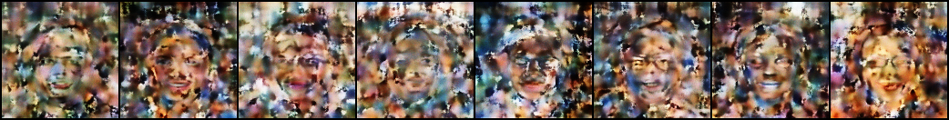
Results - Robustness to Reconstruction
Input
Applied sampled noise
Adversarial attack knowing ½ of code
Notes:
Shivansh

Slide 12
Results - Image Quality Metrics
Metric | Output, Mid resolution (k=128) | Output, Less resolution (k=64) | Sample noise distortion | Adversary random guess
Avg. PSNR | 24.344 | 16.801 | 12.817 | 11.937
Avg. SSIM | 0.846 | 0.644 | 0.301 | 0.247
Peak-Signal Noise Ratio (PSNR): Measures quality of reconstruction of compression codes for images. State of the art results are in range 30-50
Structural Similarity Index (SSIM): Range of 0 to 1, used for measuring similarity between images by distribution of pixel values
Notes:
Shivansh

Slide 13
Challenges
Overfitting/Model Design
Iteration 1: Sequentially feeding convolutional features directly to linear layers led to massive matrix (too many parameters) which led to overfitting
Iteration 2: Uniform mask sizes led to too many parameters to learn. Only trained on 5,000 images due to computation time, limiting generalizability
Computational Limits
Total dataset was too large to fully train on, so we could only utilize 1/10
Model size (# parameters) in model required larger training dataset to properly learn
GPU memory resource limited
Notes:
Howard

Slide 14
References
Razeghi et. al (2017) Privacy Preserving Identification Using Sparse Approximation with Ambiguization.
https://doi.org/10.48550/arXiv.1709.10297
Ferdowsi et. al (2020) Privacy-Preserving Image Sharing via Sparsifying Layers on Convolutional Groups.
https://doi.org/10.48550/arXiv.2002.01469
Ferdowsi, S. (2019) Learning to compress and search visual data in large-scale systems.
https://arxiv.org/abs/1901.08437
Tewari et. al (2017) MoFA: Model-based Deep Convolutional Face Autoencoder for Unsupervised Monocular Reconstruction
https://doi.org/10.48550/arXiv.1703.10580

